Slide 1
RentShare
Institute of Data Capstone Project
Lily Barrett-Power
Notes:
Good morning everyone. Today I’m going to talk to you about my capstone project, RentShare.
I came up with the project idea because I was thinking about the stuff that we have lying around home that we only use once every couple of years and was thinking it would be good to make some extra income from these underutilized goods.

Slide 2
Purpose
RentShare is an application where users can rent and borrow goods of any description from other users
Minimise excess production and consumption mindsets
Notes:
The purpose of RentShare is to bridge the gap between people who have items they would like to rent out and people who need short term access to these items.
I felt that an application that facilitates the renting and sharing of existing items is a gap in the current market that helps address the problem of over production and over consumption.
Instead of people going out and buying an item new from a store, they can essentially borrow these items from other people in the community. Which in turn reduces the need for production.

Slide 3
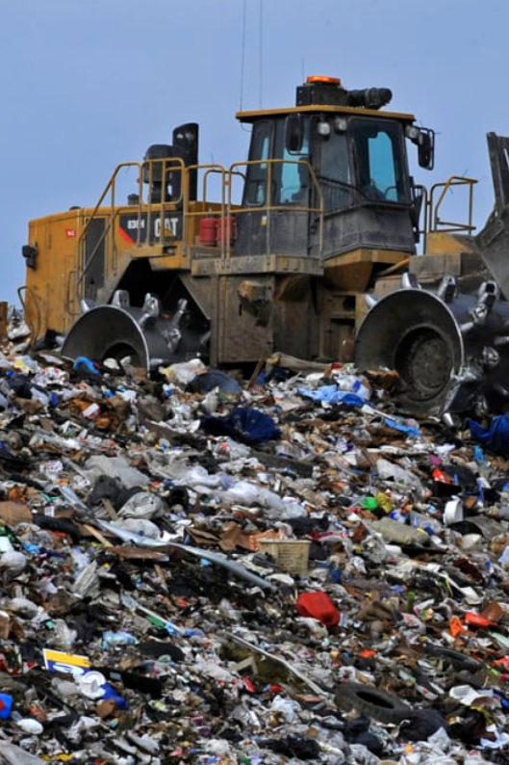
Why?
Over consumption and over production are contributors to global warming
Nearly everyone has belongings sitting at home that they hardly ever use, yet they cannot bare to get rid of
Why not make some extra money from them??
Notes:
Over production and consumption are huge contributors to the current state of global warming.
In 2015 a study was done that showed that production and consumption of household goods was responsible for 60% of global greenhouse gas emissions (https://doi.org/10.1111/jiec.12371)
Currently, around 1.35% of global oil consumption goes to the production of materials used to produce clothing.
Over production is a huge contributor to global warming. By creating an application that helps to minimize these emissions, I am making a step to helping global warming.

Slide 4



Projects similar to RentShare
LaRent –
https://larent.co.nz/en-GB/infos/about
Designer Wardrobe –
https://designerwardrobe.co.nz/?gclid=CjwKCAiA75itBhA6EiwAkho9e5qWM-_TJ2papLxNoUtTpQ4xyDZgoUOtIH2fuxpPgs0fHhCJltidGxoC1-AQAvD_BwE
Facebook marketplace, Trademe, & eBay
Notes:
There is one similar project to RentShare currently in New Zealand.
LaRent is a platform that allows users to buy and rent items online, however the website is hard to find and no-one I have spoken to has heard about LaRent
Designer Wardrobe is a platform that allows users to rent designer clothing, this is a popular platform in NZ. However, it operates in a niche market.
RentShare caters to a larger audience than Designer Wardrobe as it caters for all sorts of belongings, from farm equipment to homeware to jewelry and electronics.
LaRent is the closest thing to RentShare, concept wise. However they allow for the selling of belongings too, I have kept RentShare to the RENTING of items as there are lots of VERY well known selling platforms, like Trade-me and Facebook Marketplace. By keeping RentShare to the rental of items I am solidifying RentShares place in the market.
LaRent also has listings from around the world which I would limit RentShare to items located in NZ.

Slide 5
Current state:
In NZ most peer-to-peer economy cater to people wanting to SELL items
The current rent-sharing platforms are poorly set up and not well known
Desired state:
More users in NZ
Easy to find, access and use
Notes:
The current state of the industry in New Zealand for renting belongings is poor.
Most peer-to-peer economy platforms in NZ focus on selling and buying goods. Think of Trade-me, Facebook marketplace and Ebay.
The desired state of the industry is a large community that can easily find, access and use the application to facilitate goods sharing between people in New Zealand.

Slide 6
Peer-to-peer economy industry value chain
Marketplace creation
Gain users
User interaction
Financial transactions
Item pickup/delivery
Notes:
The peer-to-peer economy industry makes money by getting users to sign up to the application, the users would interact with the application, scrolling through items that are for rent (and perhaps seeing paid ads between listings or down the side). Users then make financial transactions for the items and get them delivered/pick them up.
The industry would make money from the ads that display on the application, for this to work the application needs to have a large user base to warrant people paying for a spot to house their ads
The industry may also make money from the transactions, generally a percentage would be taken transaction for the industry.

Slide 7
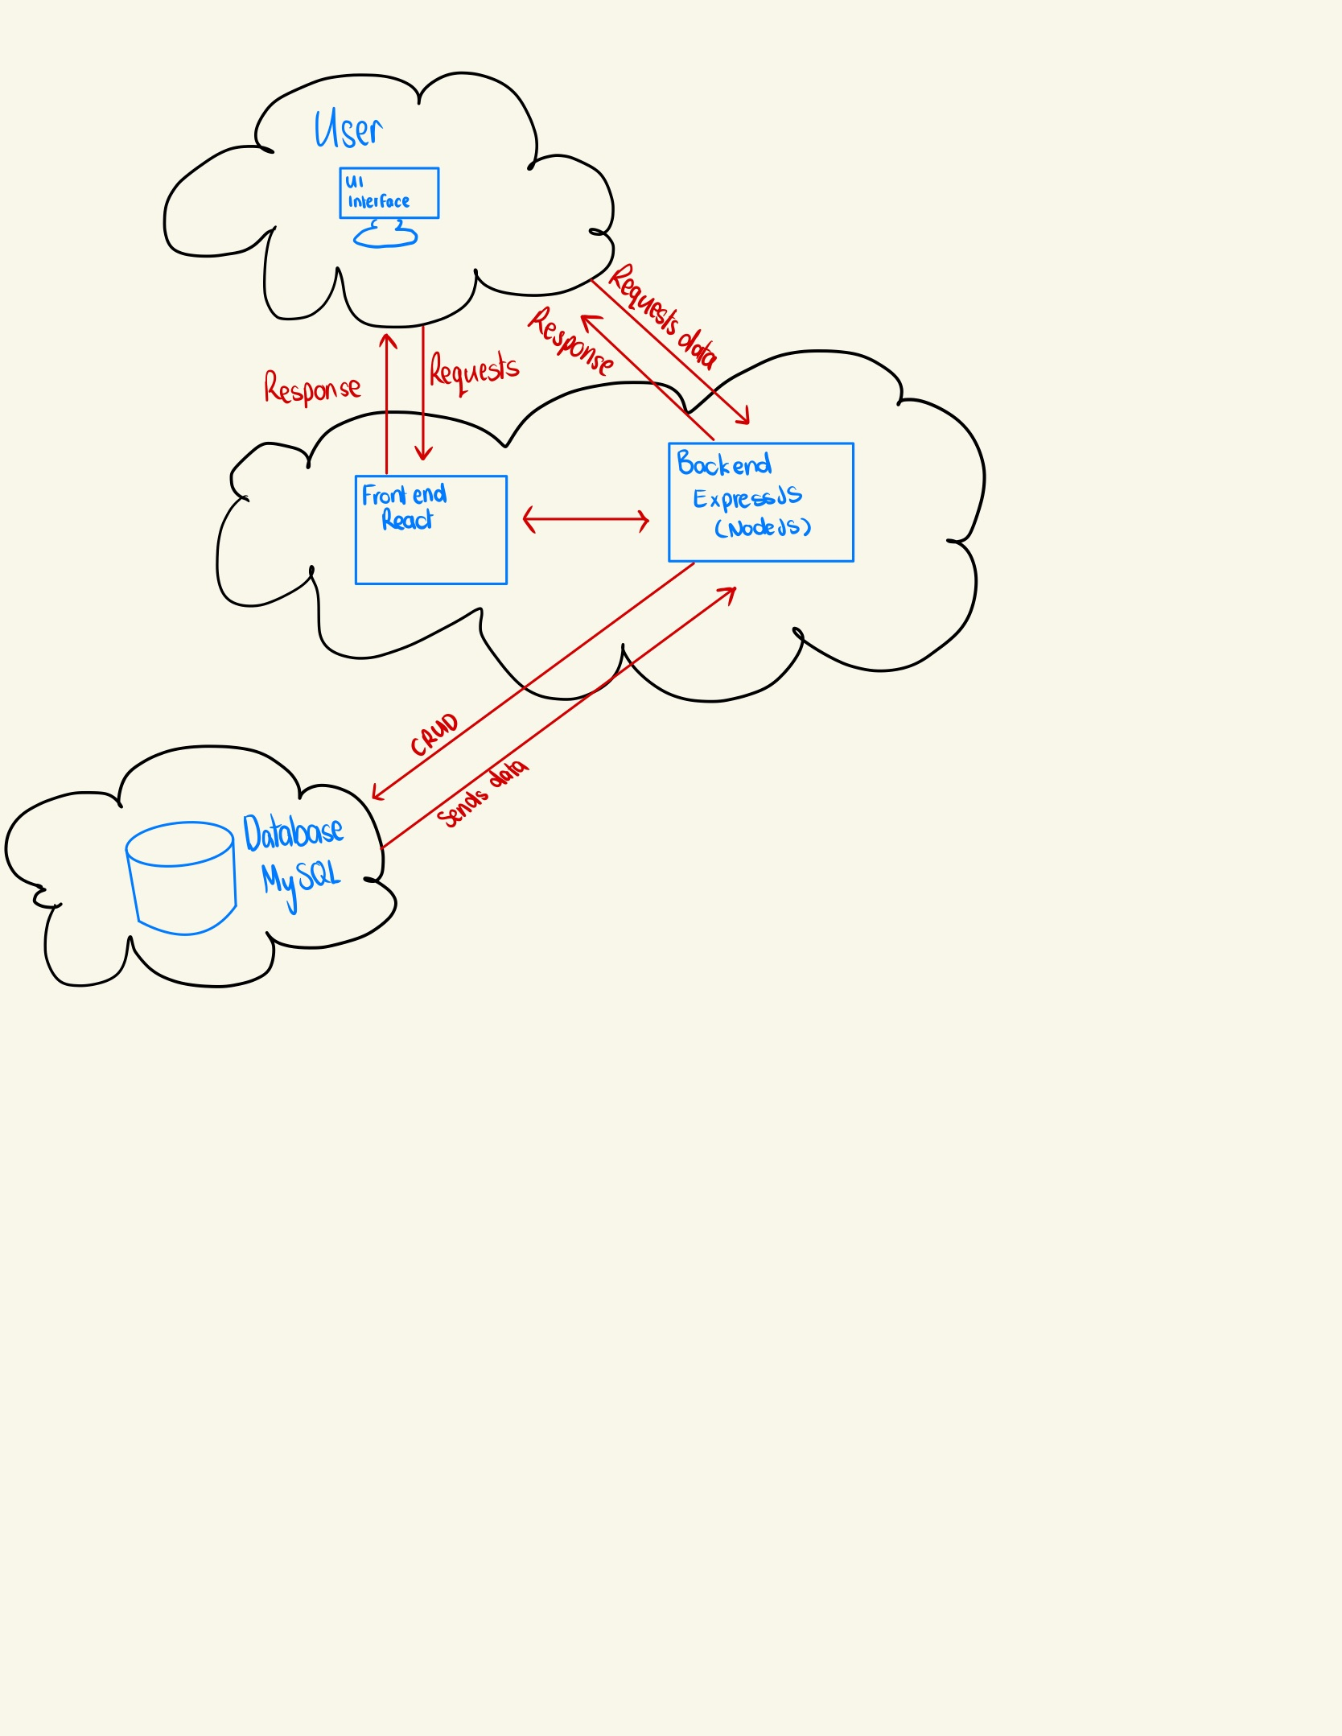
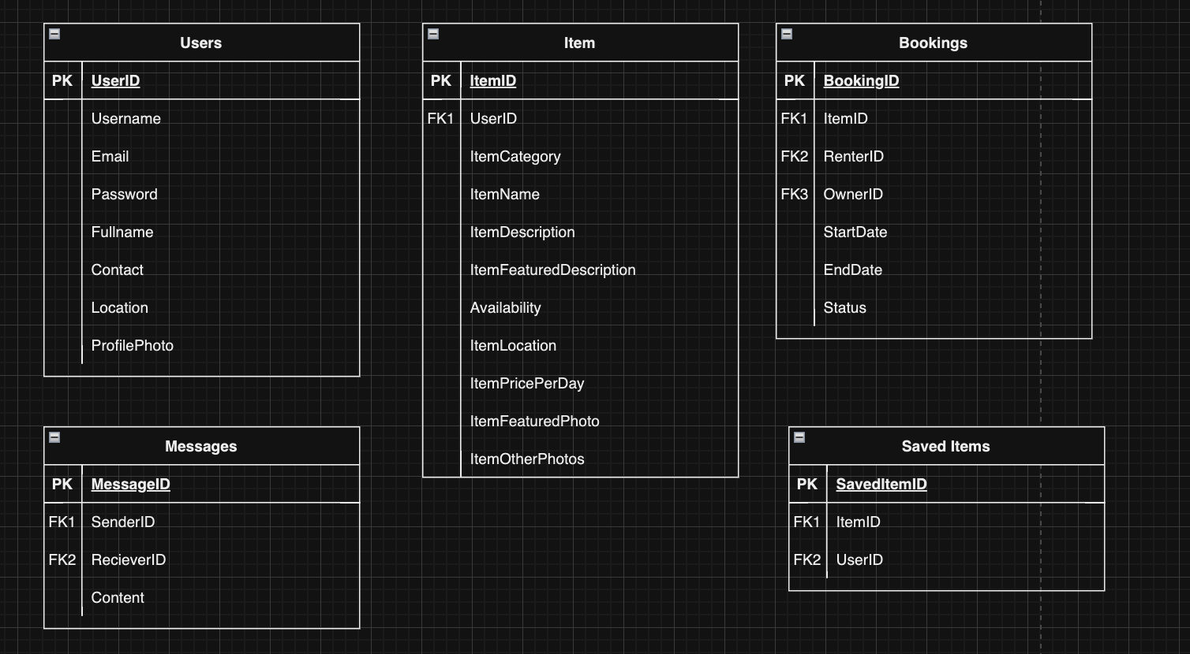
Product design - Architecture
Diagram Physical models
Notes:
The architecture of the applications includes a front-end, backend, database and the user.
The front-end was constructed with React
The backend was donw with Express and NodeJS
The database management system I used was MySQL
The database was set up by creating a logical and physical model of the database design, the physical model is on the screen. I included 5 tables that meant I was able to do the required CRUD operations to carry out any of the necessary tasks in RentShare
I also used Socket.io for real-time chats, which integrates with the database for long term storage and historical message searching
When a user does anything that requires the back-end (signing up, posting an item, messaging etc), it does a REST call to the backend which may carry out CRUD operations on the database

Slide 8
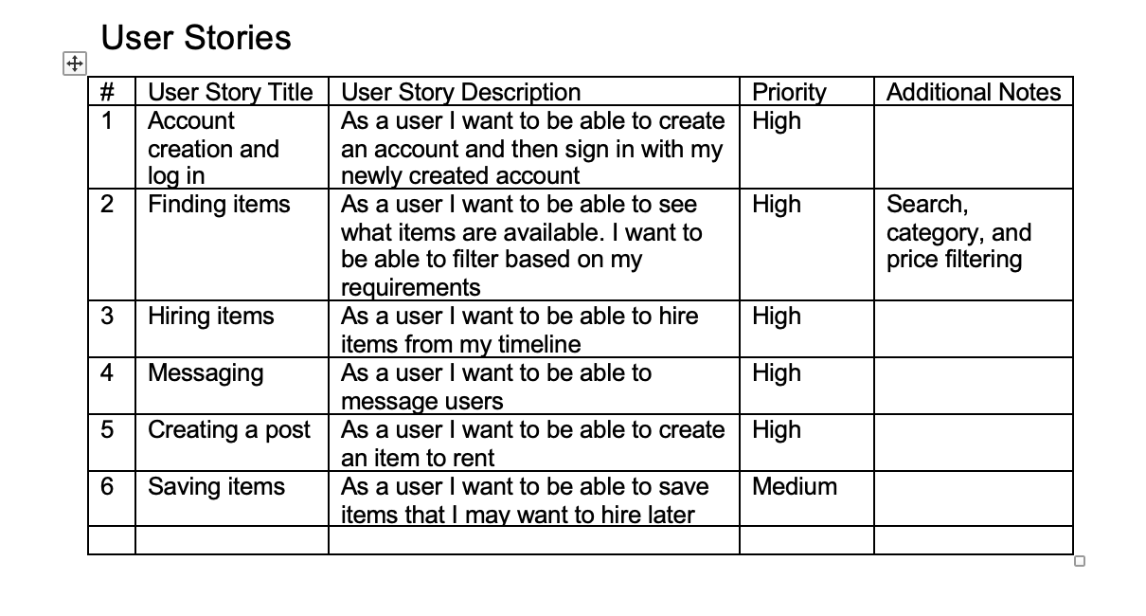
User stories
Notes:
RentShare has a user story for every major functionality, including Browsing items on the browse page, for example. As a user I want to be able to see what items are available, and I want to be able to filter the results based on my preferences

Slide 9
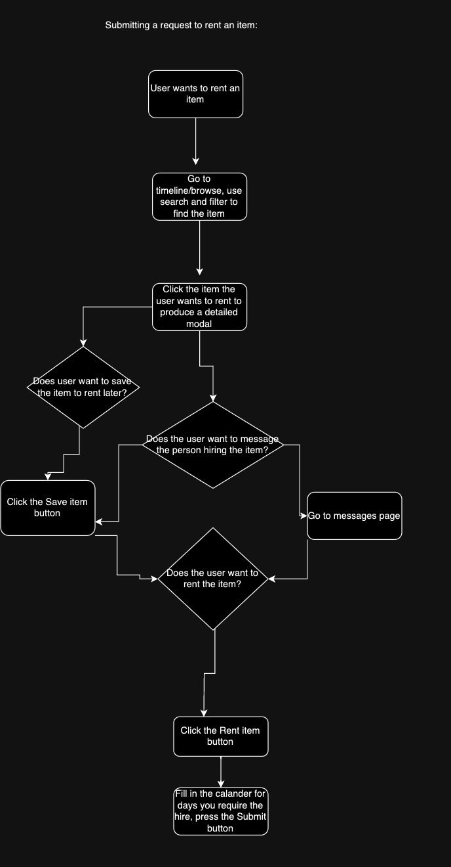
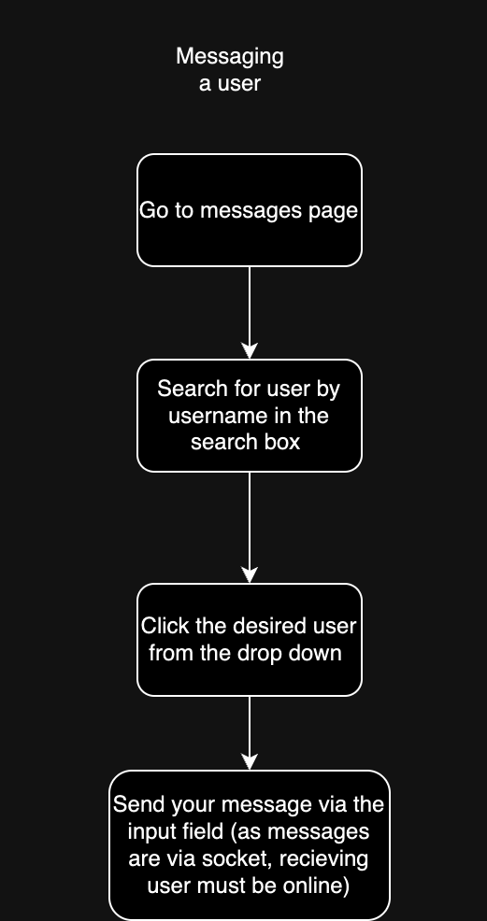
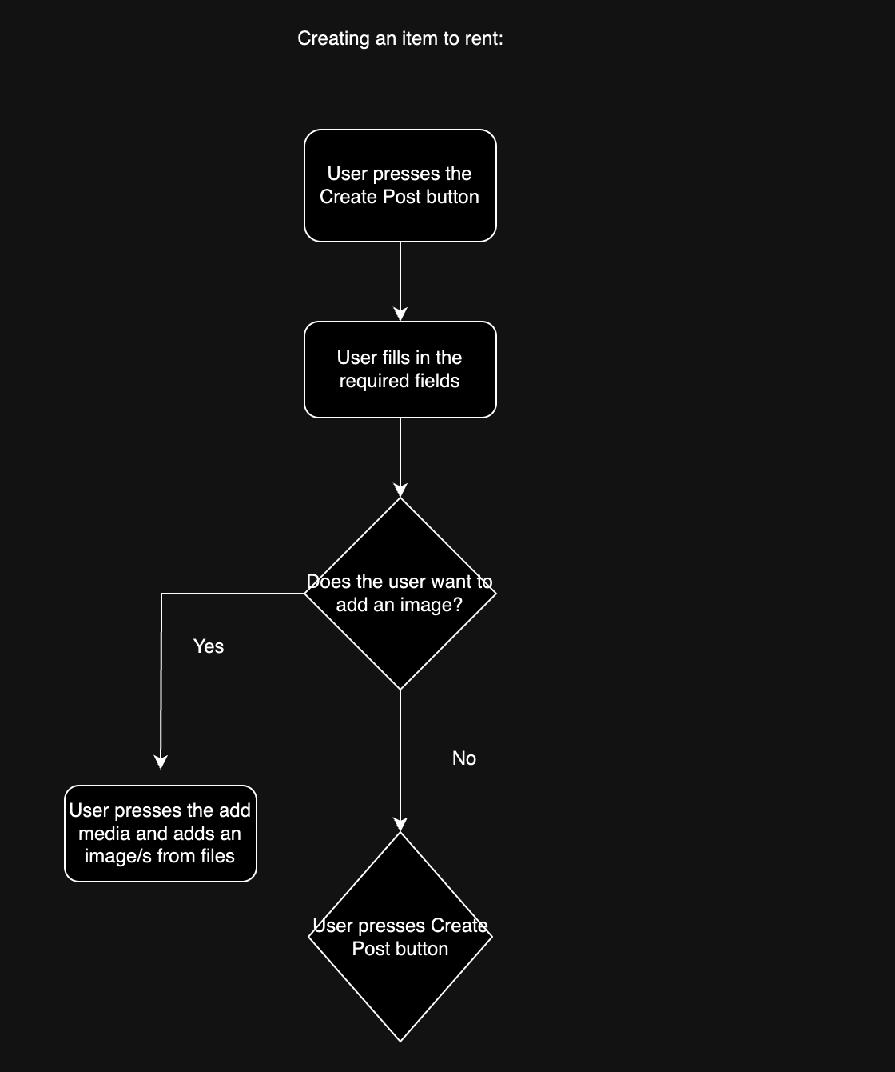
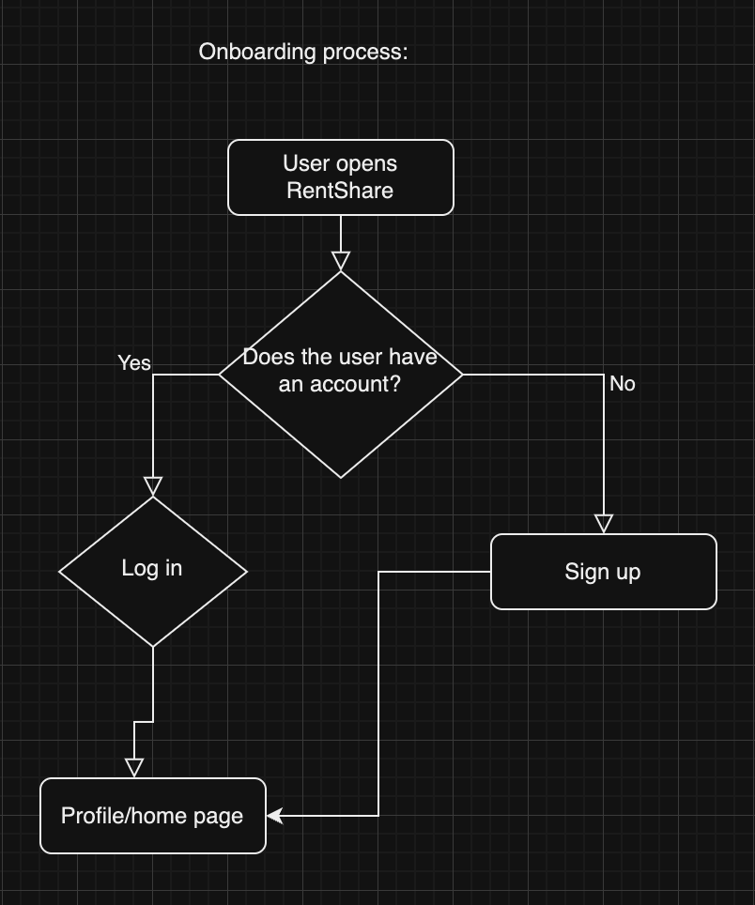
User flows
Notes:
All major features had a user flow created. For example, the onboarding process:
- a user opens the application
- if the user has an account, they log in with their credentials
- if the user doesn’t have an account, they navigate to the sign up page, when a new account is created, the user is automatically logged in and goes to the profile/home page

Slide 10
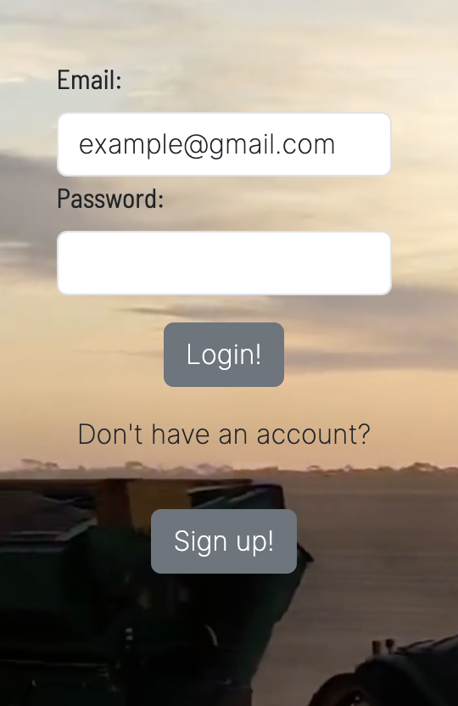
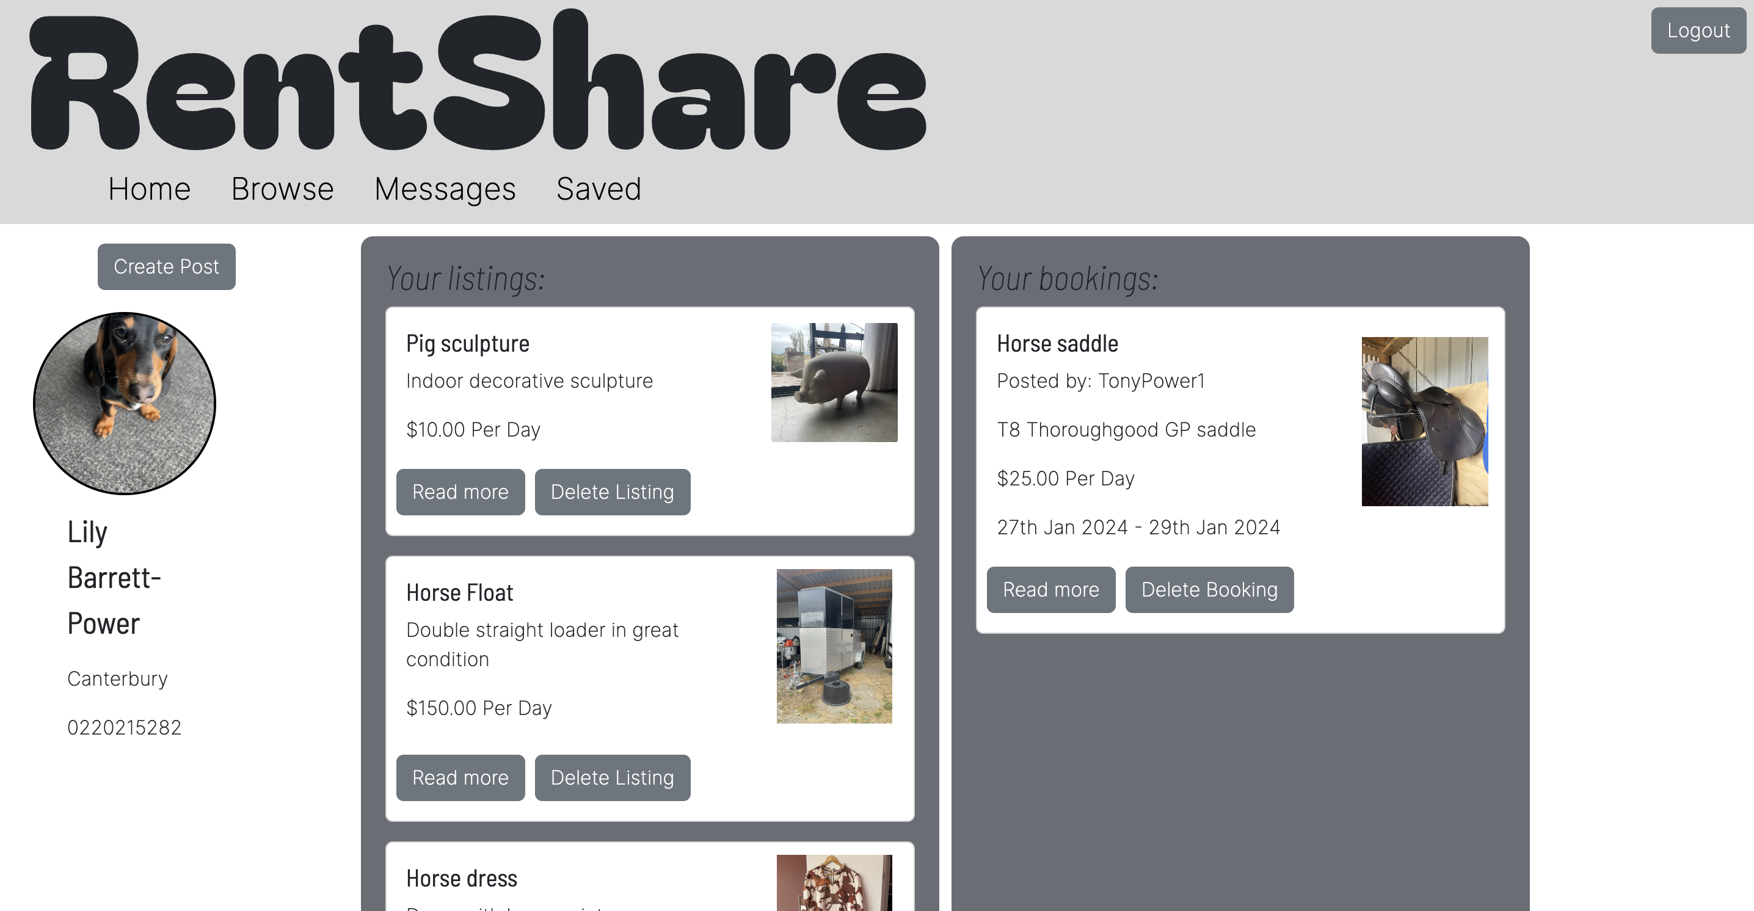
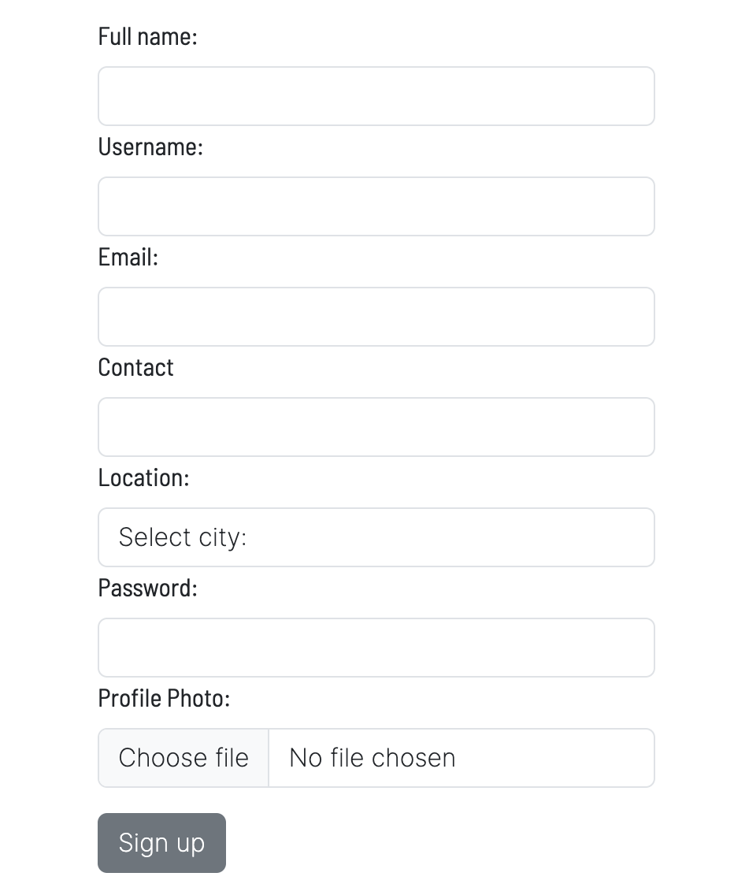
Notes:
Shows the onboarding process

Slide 11
Out of scope
Encryption/HTTPS
Notifications with ability to accept/decline bookings
Full chat with notifications
- Used Socket.io for the chat and I think that may have been a mistake, would do this differently next time
Notes:
Out of scope:
Encryption and HTTPS would be required for RentShare to move into production
I would like to implement a full notification system so that when a user requests to book an item, the owner gets a notification and can either accept or decline the booking. However I didn’t have enough time to implement this. I would also like the chat to have notifications and not just real-time messaging.
To get around this, I added a feature for searching historical messages based on the messages stored in the database but I would like for this to be more streamlined. I just ran out of time to implement this fully.

Slide 12
Non functional requirements
Personal detail storage
Load testing required
Easy to use
Seamless user experience
Notes:
The storage of personal details in the database needs to be secure. Users sign in with their password and email which are all stored in the users table in the databse
Password hashing was used with Bcrypt so that passwords aren’t stored in the database in plaintext
In able to determine how many transactions are required at peak time, I would need to do load testing
RentShare must be extremely easy to use in order to build a large community consisting of people of all technology levels
RentShare should respond to user requests as quickly as possible and be as reliable as possible in order to provide a seamless user experience. The more time the applications spends being down is the less reliable the application gets. Should this be the case, users will be get fed up and stop using the it
The software conforms to technical standards by the backend being in an MVC structure and the front-end re-using components. In the front end I could of used custom hooks more for fetching the data from the database, this is something I would do differently if I were to do this again.

Slide 13
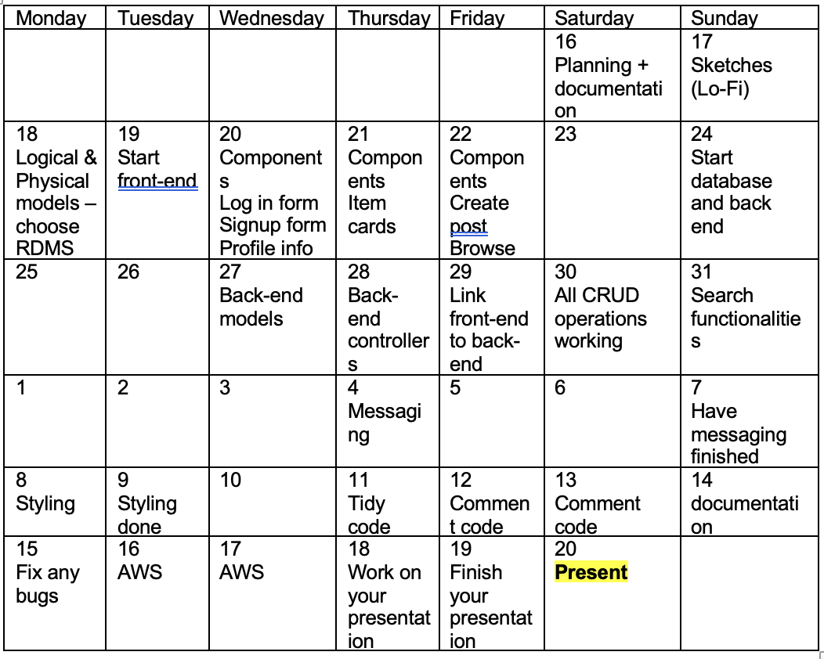
Planning
Notes:
For my project planning I made a table in word and stuck to it the best I could. I also used check lists on my iPad to go into more detail about what I needed to do. Checking them off as I completed the tasks.
Whenever I merged a branch I was working on to the main branch, I put in my next steps in the description so I knew where I was up to

Slide 14
Testing
Thunderclient CRUD testing
Manually tested each component separately
Tested the whole application together
Got a second opinion
Reviewed and commented code
Notes:
I used thunderclient in VS code to test my database routes
I created each new component/ section of code on separate branches and tested them separately before integrating them into the main branch and testing the whole application together
In my profile info component and items card I tested the components with dummy data before integrating the database to ensure the front end displayed the data how I wanted it to
I also got my dad to test the whole application by creating an account, posting items, booking items, saving items and messaging. This helped me gauge whether the application was easy to use and functional
I then reviewed, tidied and commented my code so that its easy for me to continue working on this project

Slide 15
Implementation
The application is not hosted on AWS so can only be used locally
The application met the minimum requirements
Notes:
I didn’t end up hosting my application on AWS, however this is something I would like to do in the near future.
So currently the application can only be run locally
I think the application meets all the minimum requirements set out for the capstone project, however, there are some things that I will be working on post presentation!

Slide 16
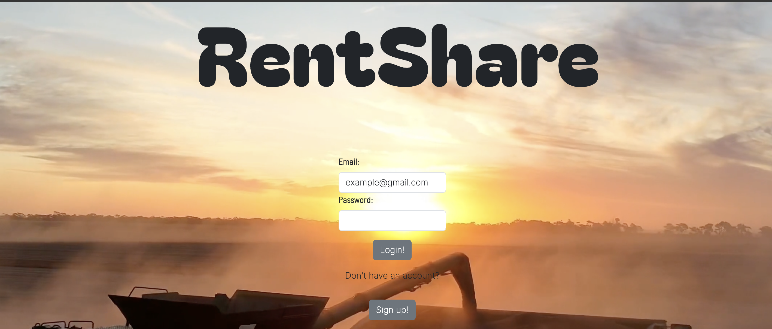
DEMO

